Slide 1
Data Structures Algorithm and Design SSZG519
Mr. Chennupati R Prasanna

Slide 2
SSZG519-Dijkstra’s Algorithm

Slide 3
Outline
Single-Source Shortest Paths
Algorithm for Unweighted Graphs
Algorithm for Weighted, Directed Acyclic Graphs (Weighted DAGs)
Algorithm for Weighted, Directed Graphs with no negative weights

Slide 4
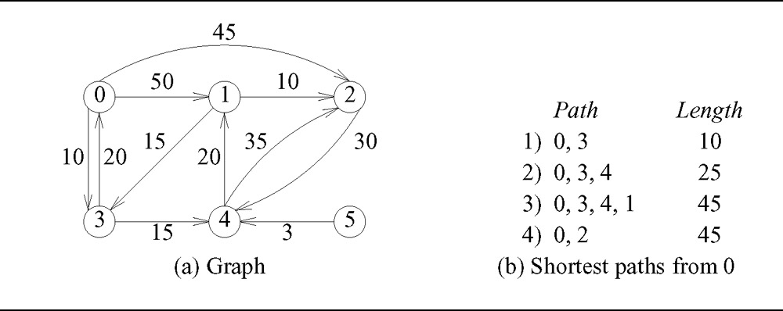
Single-Source Shortest Paths
Give a graph G = (V,E), we want to find a shortest path from a given source vertex s ∈ V to each vertex v ∈ V
Why is vertex 5 not included in the list?

Slide 5


Single-Source Shortest Paths
What problems might occur with these two special cases?

Slide 6
Properties of Shortest Paths
Can a shortest path contain a cycle?
At most how many edges will a shortest path contain?

Slide 7
Unweighted Graphs
What algorithm can be used to find the shortest paths for unweighted graphs?

Slide 8
Shortest Paths Algorithms for Weighted Graphs
For each vertex v ∈ V, we maintain attributes:
d[v] : shortest-path estimate (upper bound on weight of shortest path from source s to v)
π[v] : predecessor of v on shortest path so far
Initially d[v] is ∞ and π[v] is NIL :
INITIALIZE-SINGLE-SOURCE(G, s)
for each vertex v ∈ V[G]
d[v] ← ∞
π[v] ← NIL
d[s] ← 0

Slide 9
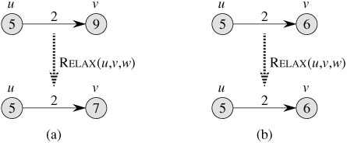
Updating Adjacent Vertices
RELAX(u, v, w)
if d[v] > d[u] + w(u, v)
d[v] ← d[u] + w(u, v)
π[v] ← u

Slide 10
Algorithm for Weighted DAGs
AG-SHORTEST-PATHS(G, w, s)
topologically sort the vertices of G
INITIALIZE-SINGLE-SOURCE(G, s)
for each vertex u, taken in topologically sorted order
for each vertex v ∈ Adj[u]
RELAX(u, v, w)

Slide 11
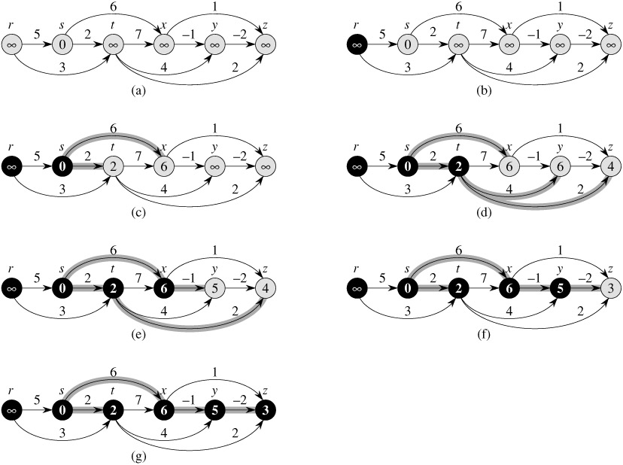
Example
Shortest paths are always well-defined in dags. Why?

Slide 12
Dijkstra’s Algorithm
DIJKSTRA(G, w, s)
INITIALIZE-SINGLE-SOURCE(G, s)
S ← ∅
Q ← V[G]
while Q ≠ ∅
u ← EXTRACT-MIN(Q)
S ← S ∪ {u}
for each vertex v ∈ Adj[u]
RELAX(u, v, w)

Slide 13
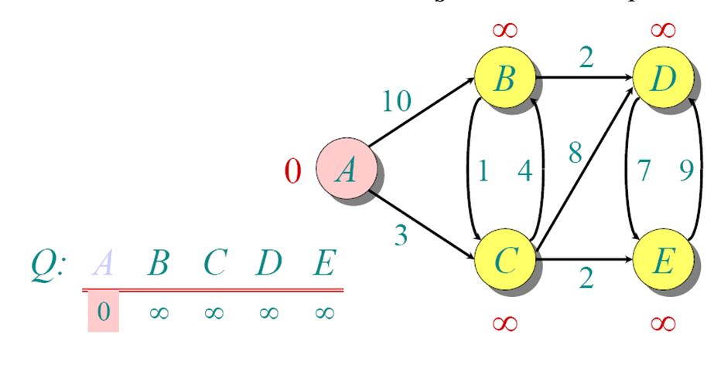

Slide 14
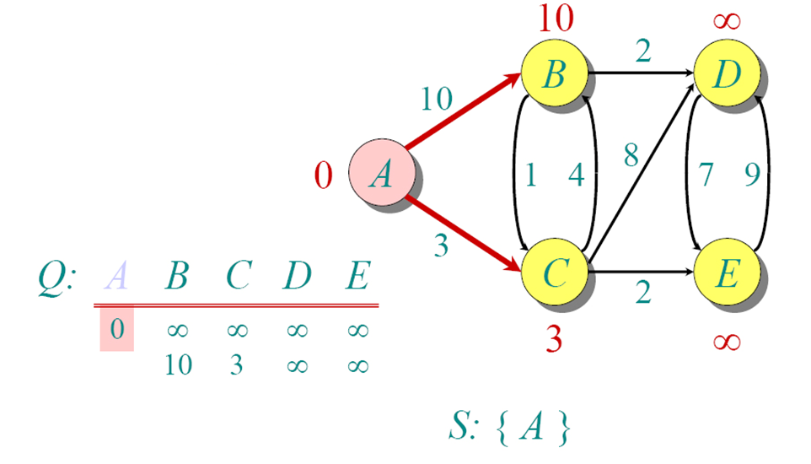

Slide 15
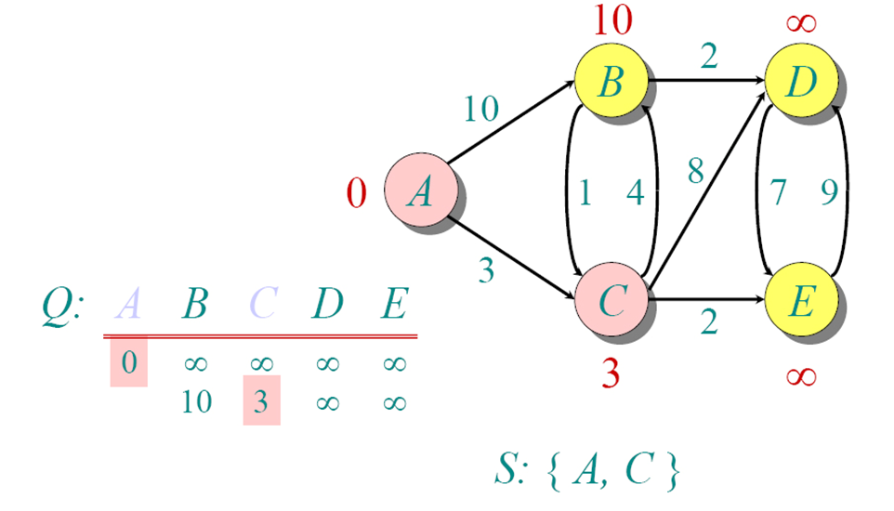

Slide 16
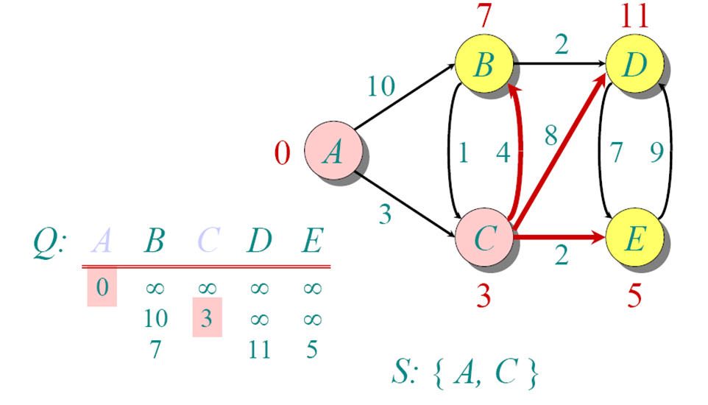

Slide 17
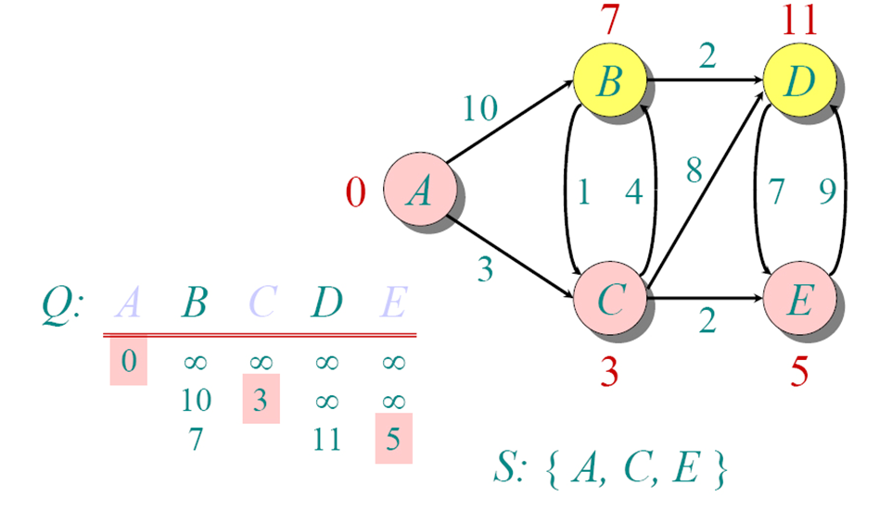

Slide 18
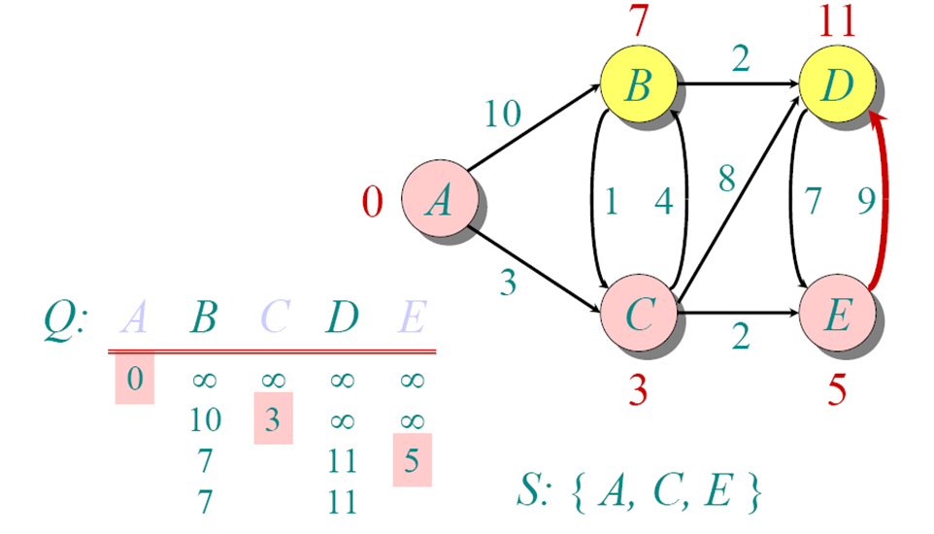

Slide 19
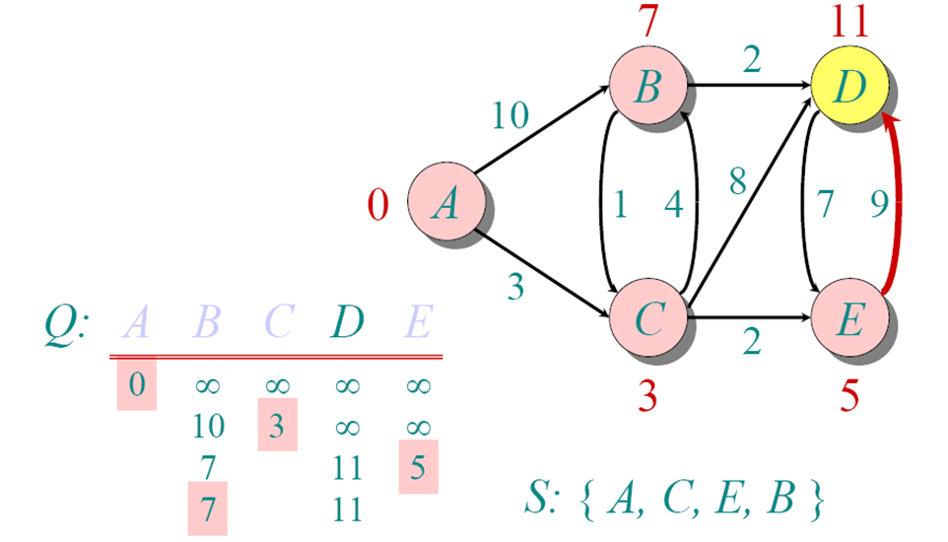

Slide 20
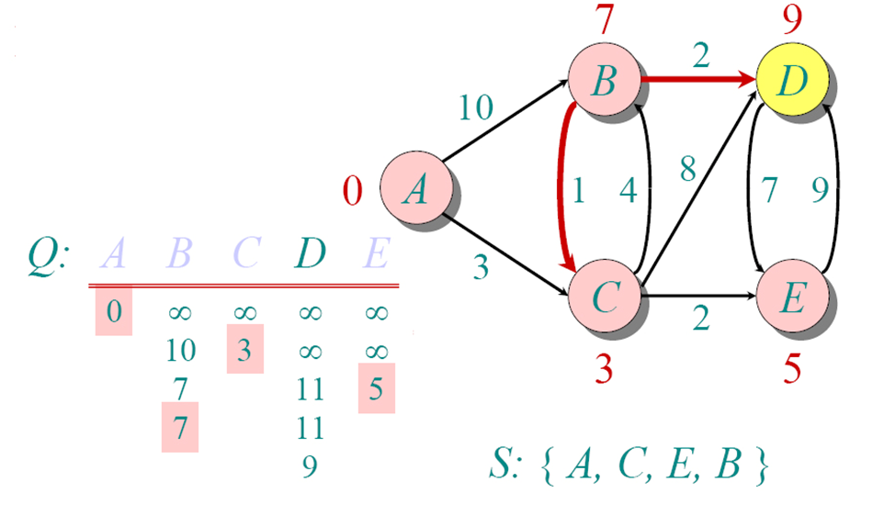

Slide 21
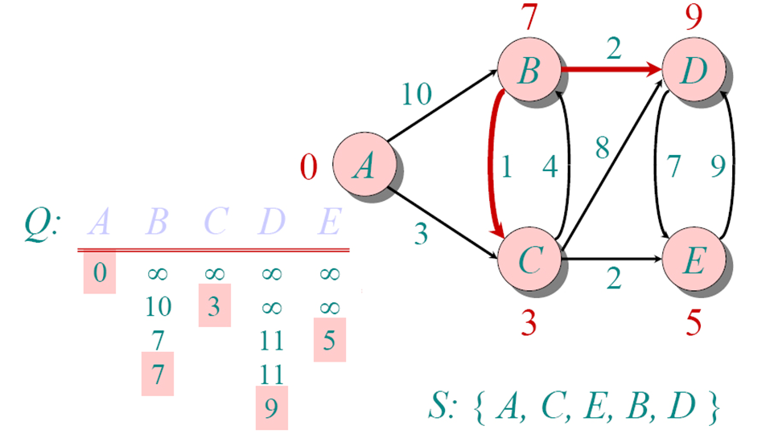

Slide 22
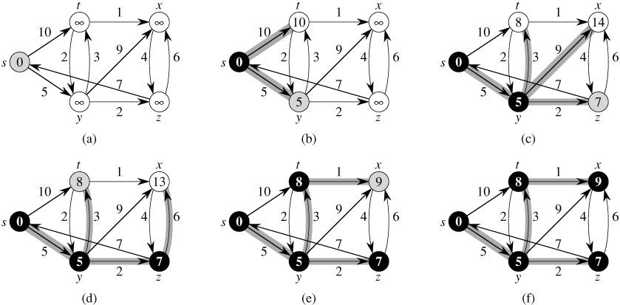
Example- try to explore

Slide 23
Thank You!!

